Slide 1


Shallion Support
Where Compassion Peaks and Support Prevails

Slide 2




The Problem
Up to 90% experience debilitating fatigue impacting daily life
1 in 20 people in the UK live with Long COVID, ME/CFS, or Fibromyalgia
Isolation and mental‑health challenges worsen outcomes
Existing support is medical‑focused, costly, or generic

Slide 3
Current Prevalence Data
Table 1. Estimated prevalence of ME/CFS, Long Covid, and Fibromyalgia by city, with approximate number of affected individuals in each location
City
ME/CFS (≈0.4% of pop.)
Long Covid (≈3.2% of pop.)
Fibromyalgia (≈5% of pop.)
Glasgow (pop. ~632,000)
Edinburgh (pop. ~523,000)
Aberdeen (pop. ~228,000)
Dundee (pop. ~148,000)
Inverness (pop. ~47,000)
Perth (pop. ~47,000)
Orkney – Kirkwall (pop. ~22,000)
~0.4% (≈2,500 people)
~0.4% (≈2,100 people)
~0.4% (≈900 people)
~0.4% (≈600 people)
~0.4% (≈190 people)
~0.4% (≈190 people)
~0.4% (≈90 people)
~3.2% (≈20,200 people)
~3.2% (≈16,700 people)
~3.2% (≈7,300 people)
~3.2% (≈4,700 people)
~3.2% (≈1,500 people)
~3.2% (≈1,500 people)
~3.2% (≈700 people)
~5% (≈31,600 people)
~5% (≈26,000 people)
~5% (≈11,400 people)
~5% (≈7,400 people)
~5% (≈2,300 people)
~5% (≈2,300 people)
~5% (≈1,100 people)

Slide 4
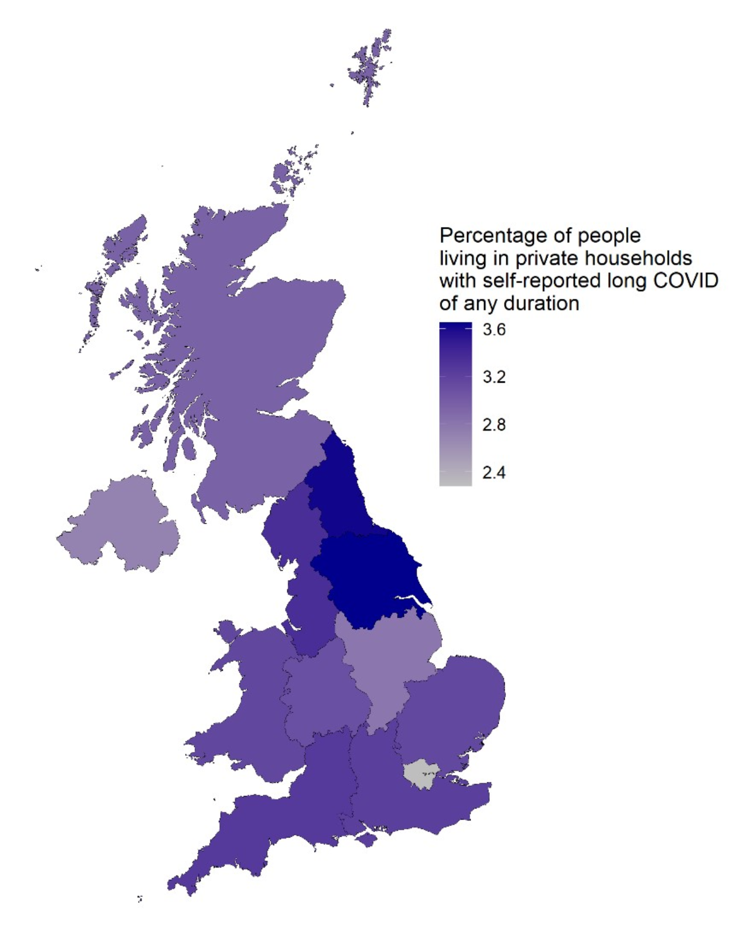
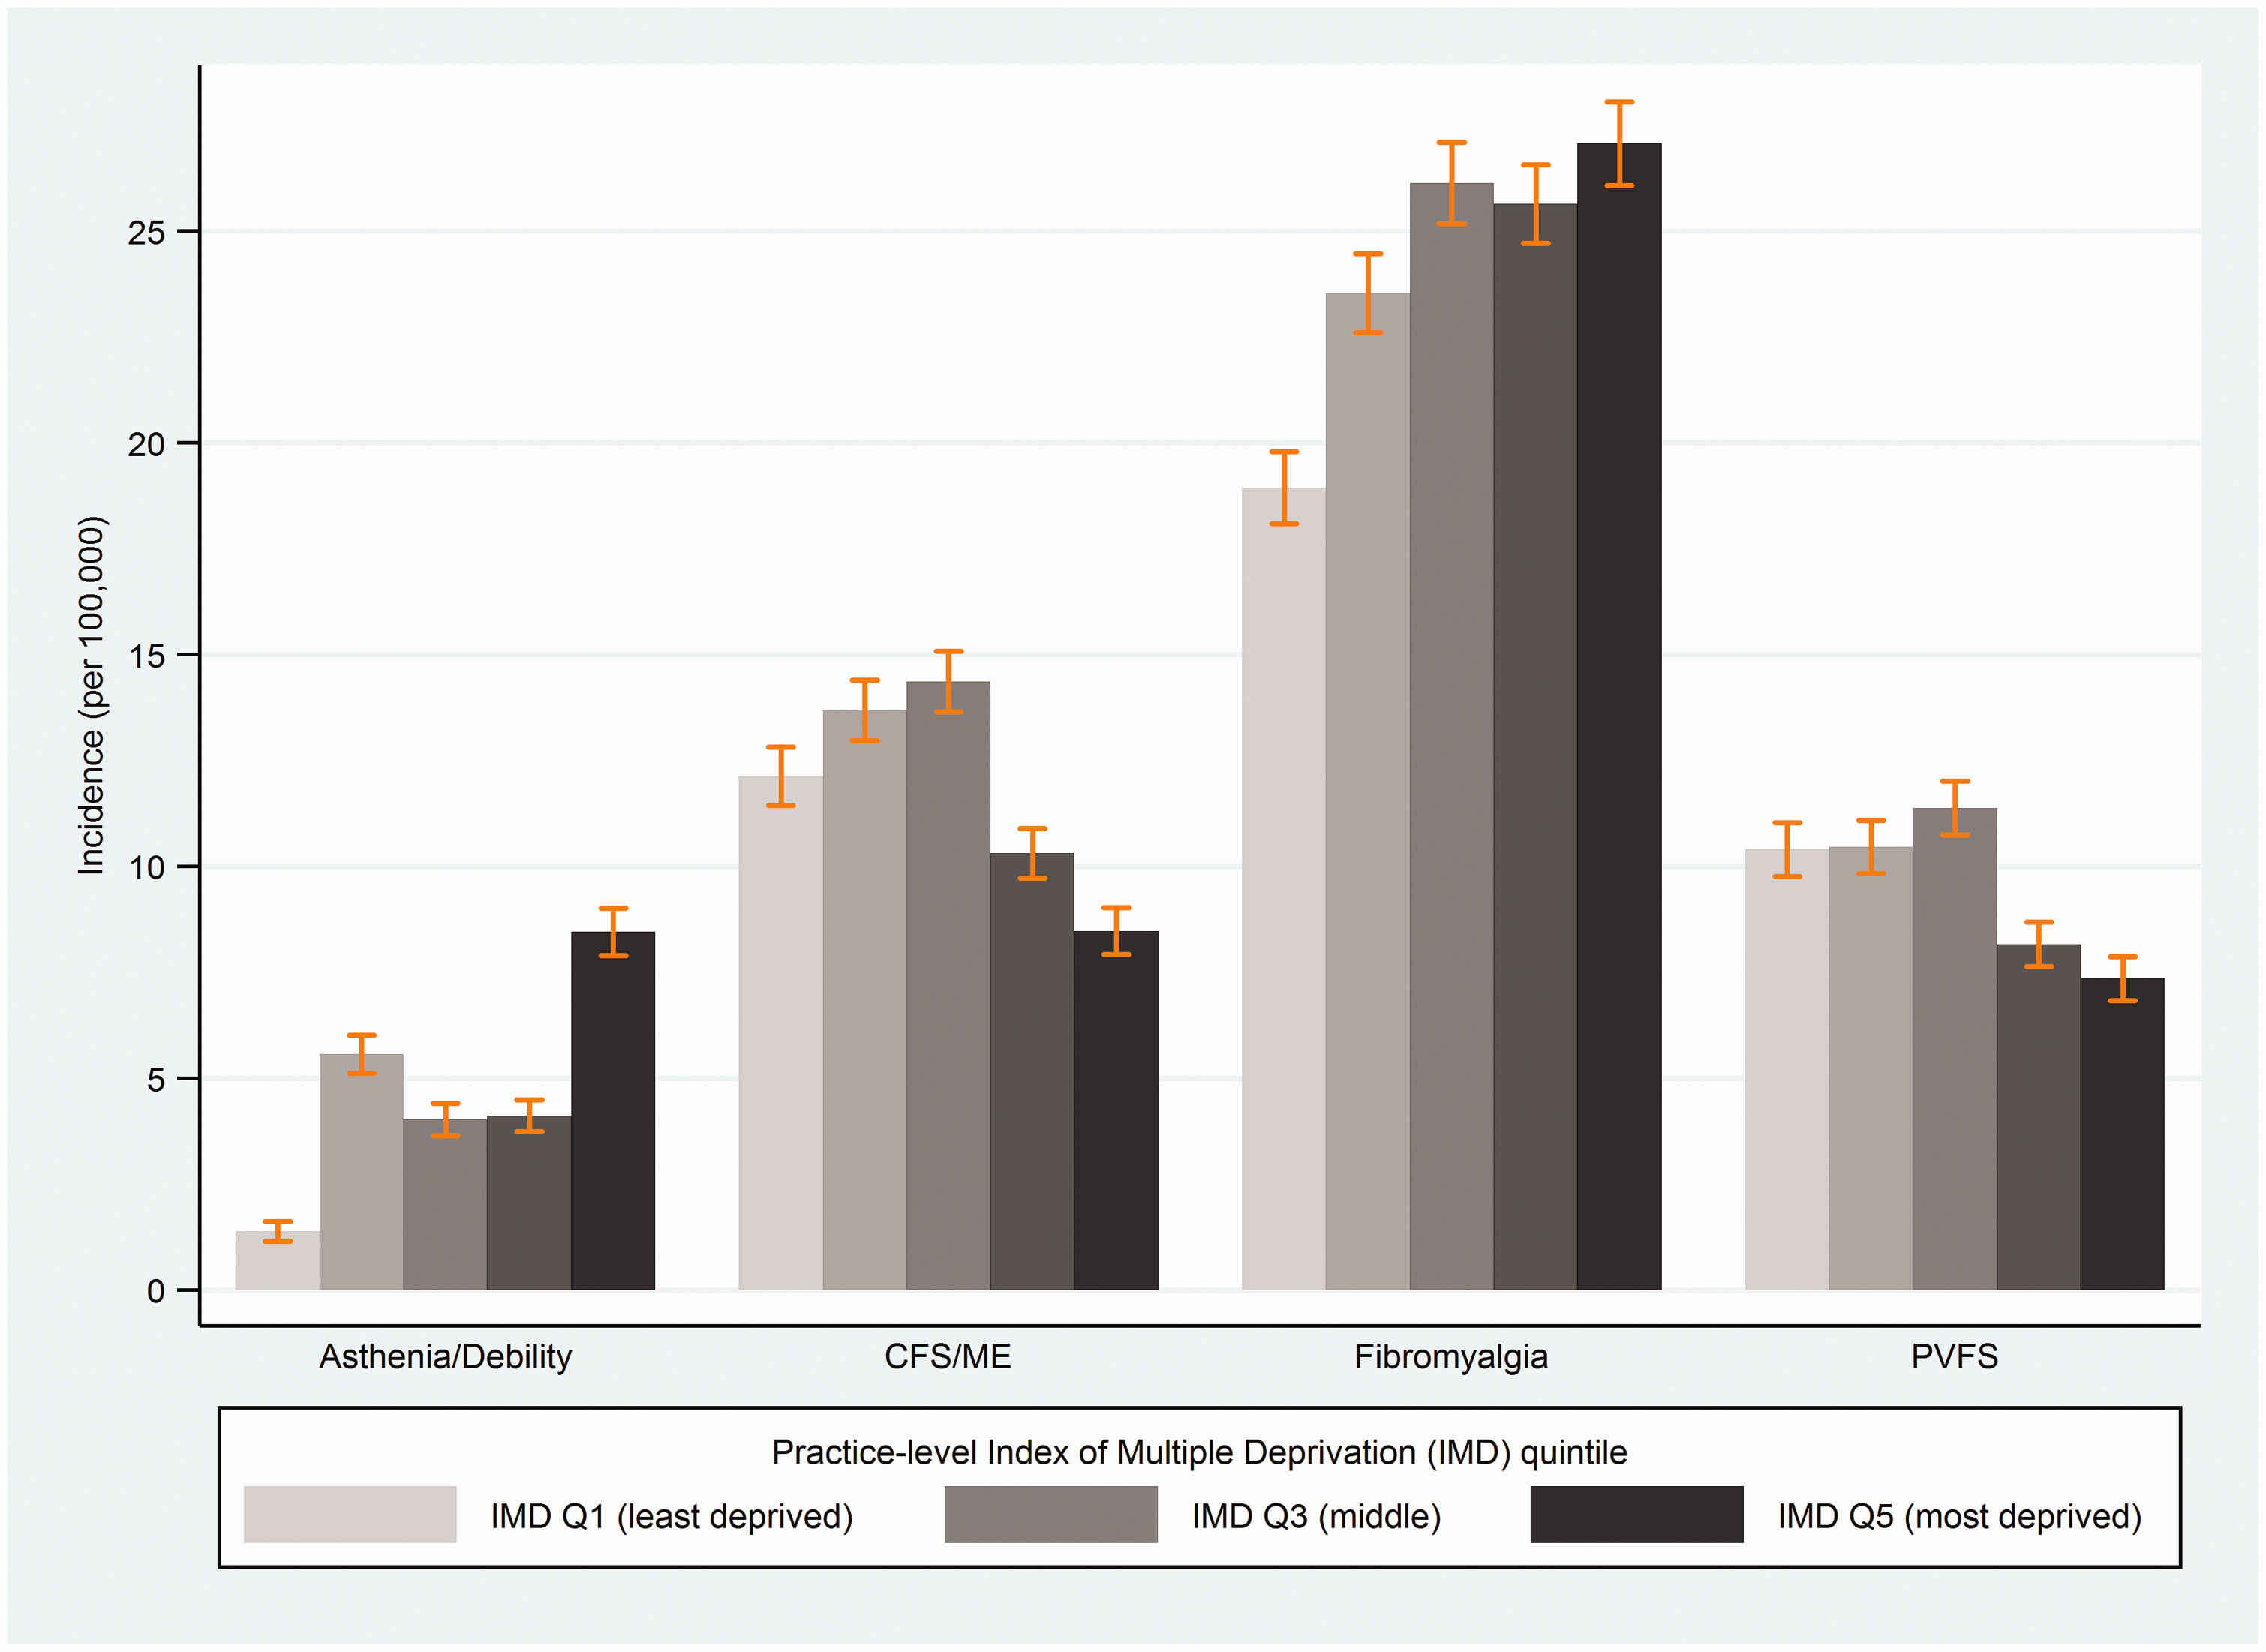
Current Prevalence Data
City
Fibromyalgia (≈5% of pop.)

Slide 5






Our Visionary Solution
1
2
3
4
Bespoke, non‑medical home‑support service
Specialised in M.E., Lupus, Fibromyalgia, PTSD & related conditions
Volunteer‑powered model reducing isolation & building community. Expansion to Hiring.
Hybrid paid + free services under social‑enterprise mission

Slide 6





How It Works
AI‑assisted matching with trained volunteers
Referral or self‑sign‑up via web/app
Continuous feedback loop to refine care
01
03
05
02
04
Free needs assessment & tailored support plan
In‑home or virtual assistance (meal prep, housekeeping, IT help, companionship)

Slide 7






Technology & Partnerships
Collaboration with University of Aberdeen computer‑science department
Matching platform & mobile app launching August 2025
Data‑driven volunteer‑client matching and scheduling
Online shop for branded merchandise & nutrition products built by MSc students
7

Slide 8





4.6 million UK residents receive disability benefits for long‑term conditions
£10 bn+ annual UK home‑care spend and rising with ageing population
Shallion bridges the gap between clinical care and daily‑living support
Dual revenue: service fees, merchandise & nutrition sales, grants & sponsorships
Market Opportunity & Social Impact
8

Slide 9





Traction & Roadmap
Q3 2025:
app launch, expansion to Greater Glasgow & Edinburgh
2024‑25 pilot
in Aberdeen:
25 clients, 40 active volunteers
95 % client‑satisfaction; 80 % report reduced isolation
2026:
Scotland‑wide coverage & 1 000+ volunteer hours/month
2027:
UK expansion to 5 major regions

Slide 10




Competitive Landscape
Traditional home‑care agencies – medical
& costly
Volunteer bureaux – limited structure
& training
Gig platforms – transactional, short‑term focus
Shallion – specialised, community‑driven, tech‑enabled hybrid model

Slide 11






Business Model & Sustainability
Merchandise & nutritious meal‑kit sales
Government & NHS referrals with funded care packages
Grants, corporate sponsorships, community fundraising
Sliding‑scale service fees for private clients
Target 45 % gross margin on paid services by 2027

Slide 12







Team & Contact
Founders: lived experience + social‑
enterprise leadership
Clinical advisor: Occupational therapist specialising in fatigue management
Technology lead: MSc Computer‑Science cohort, University of Aberdeen
Design & marketing: local creative‑
industry volunteers
Contact
hello@shallion.co.uk
www.shallion.co.uk

Slide 13
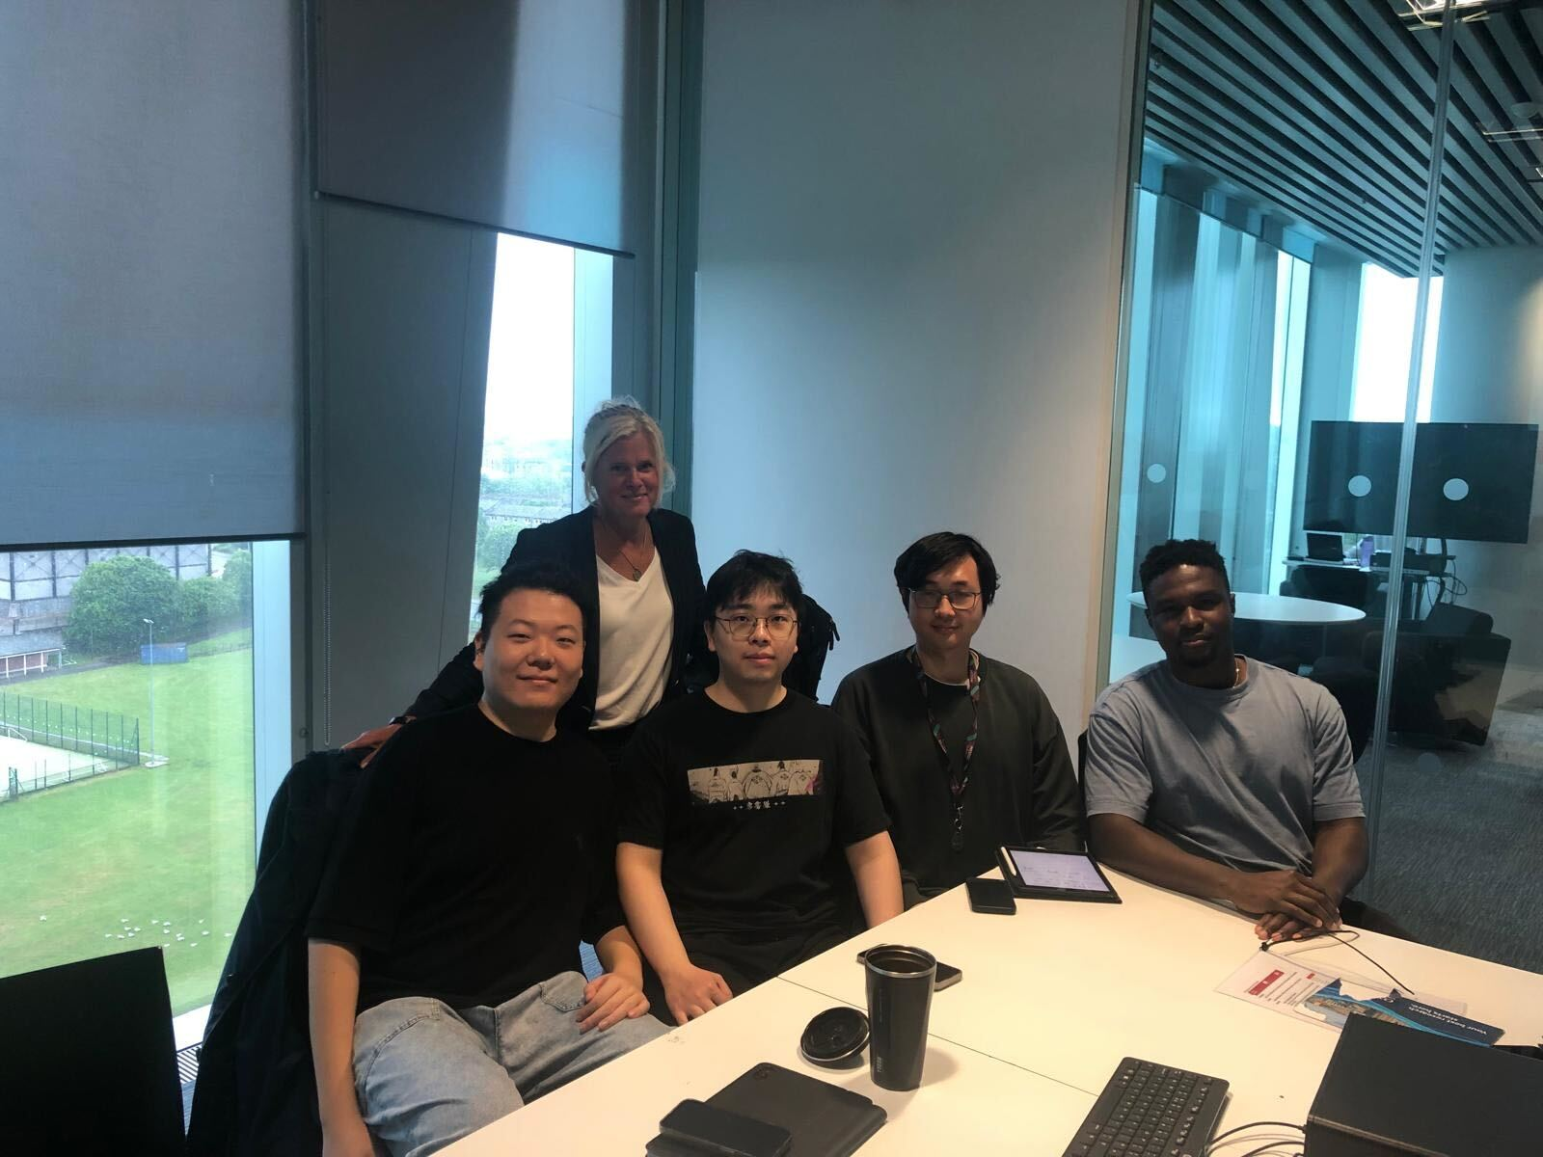

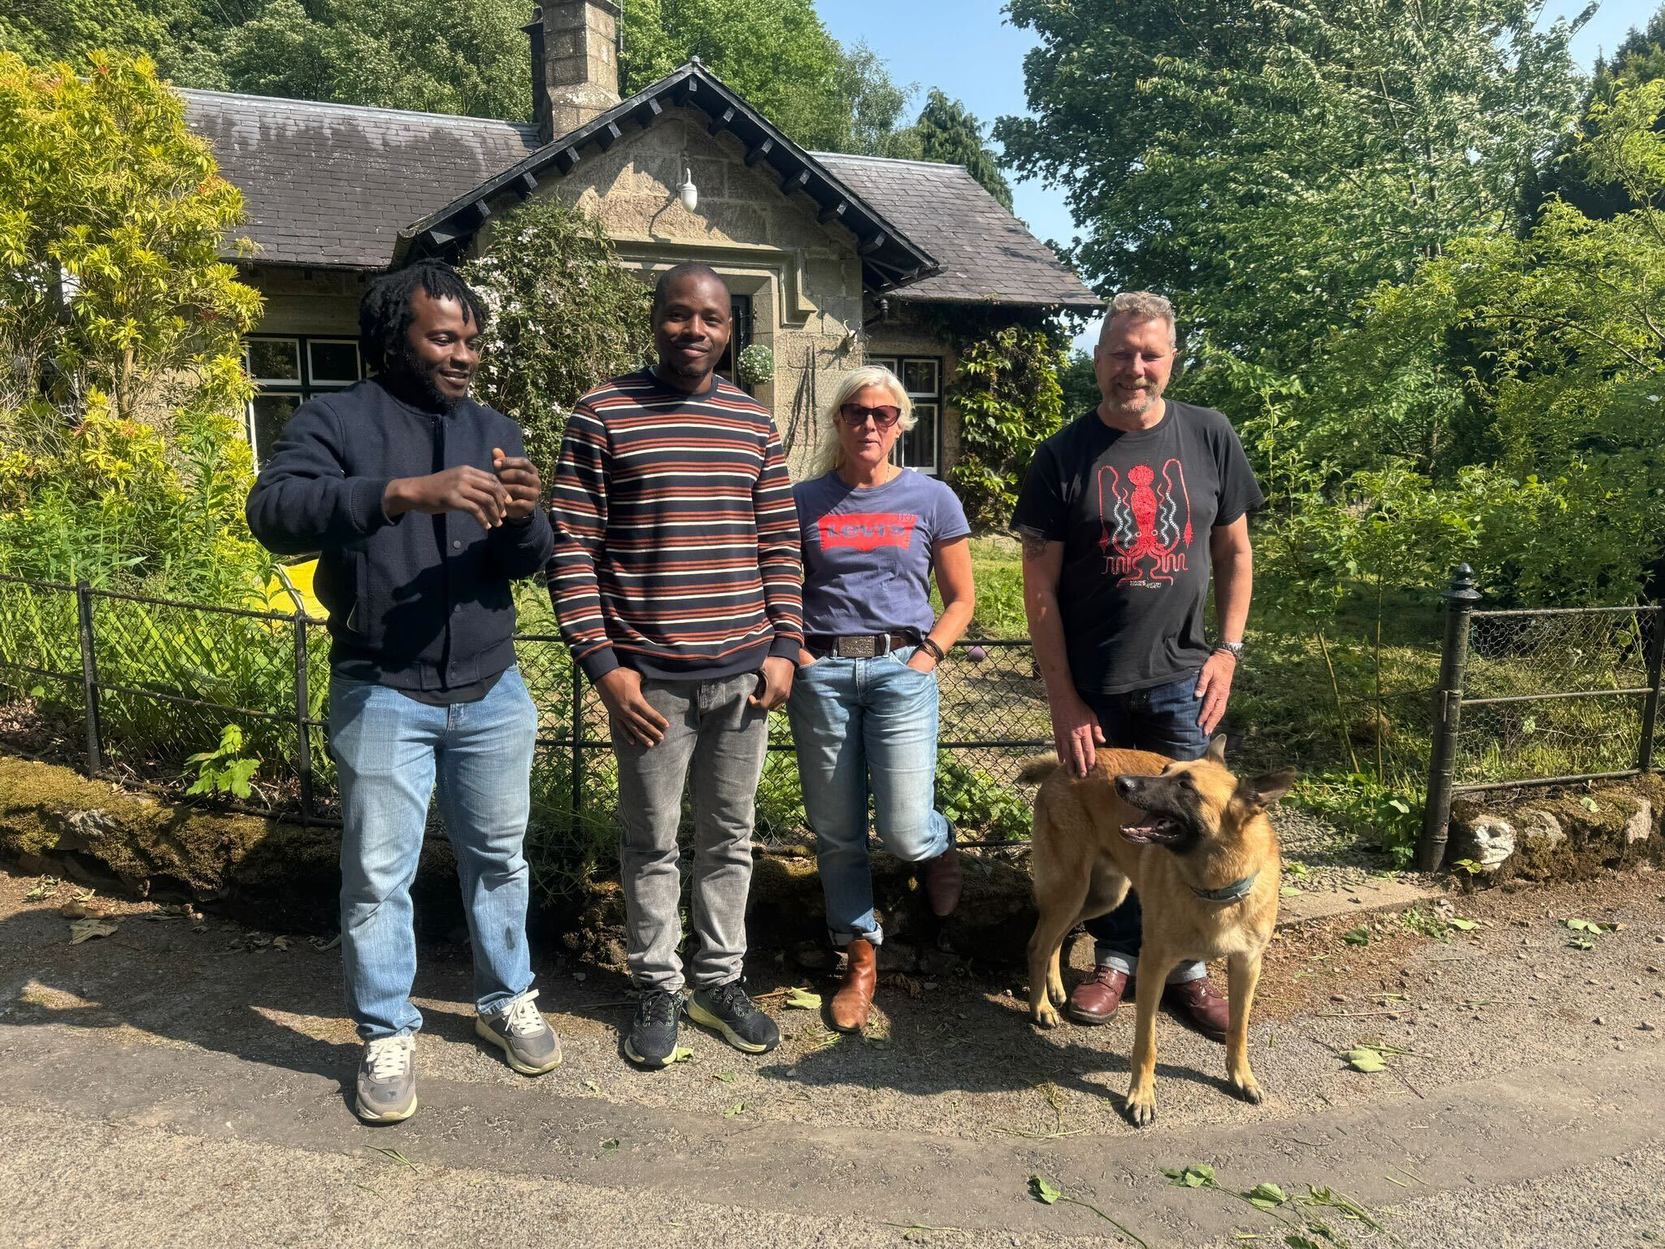
Our Team

Slide 14

20% of anything that anyone buys will go into social enterprise fund to support those to get a free service
14

Slide 15
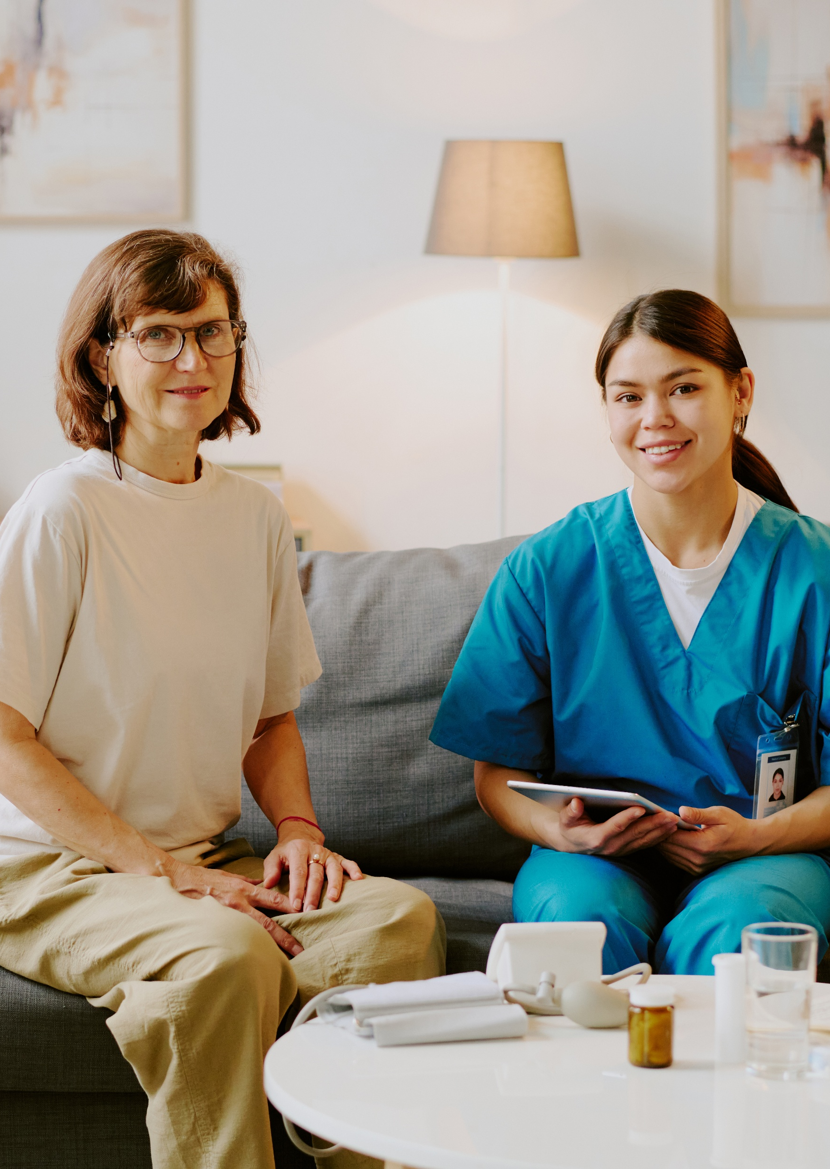
Thank You
Join us in empowering lives touched by autoimmune conditions

